Slide 1
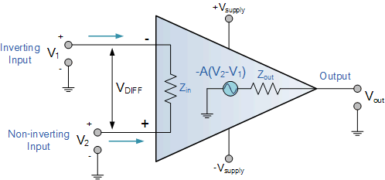

CO2015 Operational Amplifier (Op-Amp)

Slide 2
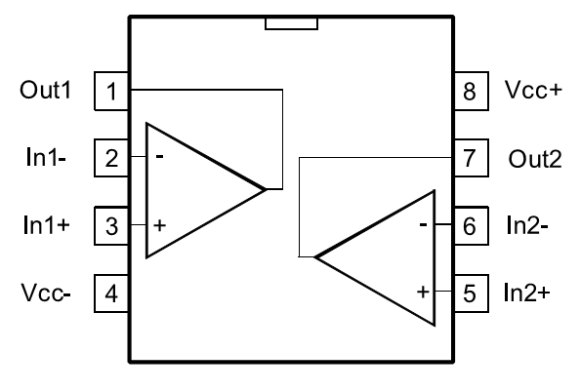
Contents
Operation
Feedback Circuit
Characteristics
Practical Applications

Slide 3
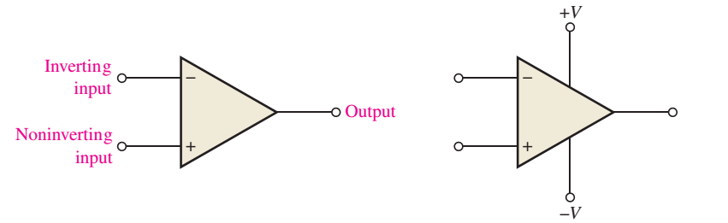
Basic Op-Amp
Op-Amp = Operational Amplifier
An Op-Amp consist
Inverting input
Noninverting input
Output
Two power supply pins (V+ and V-)

Slide 4
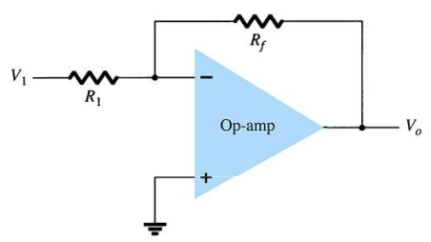
Op-Amp Gain
Op-Amps have a very high gain. They can be connected open-loop or close-loop.
Open-loop refers a configuration where there is no feedback from output back to the input. In the open-loop configuration, the gain can exceed 10⁵.
Closed-loop configuration reduces the gain. In order to control the gain of an op-amp it must have feedback. This feedback is a negative feedback. A negative feedback reduces the gain and improves many characteristics of the op-amp.

Slide 5
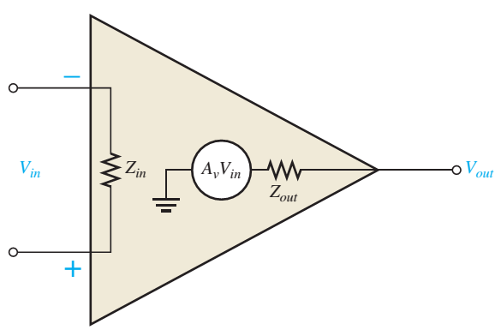
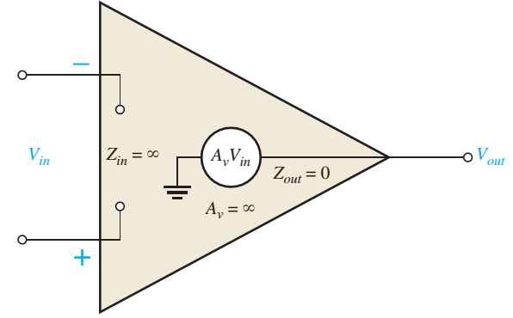
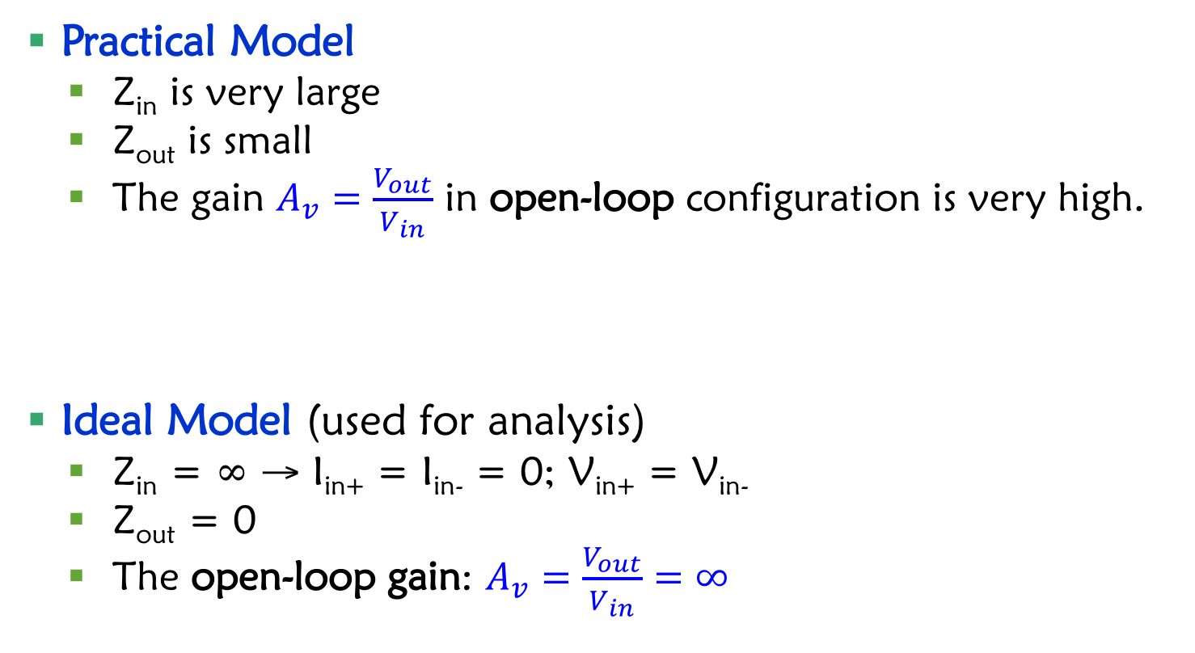
Op-Amp Models
Practical Model
Z_{in} is very large
Z_{out} is small
The gain $A_{v}=\frac{V_{out}}{V_{in}}$ in open-loop configuration is very high.
Ideal Model (used for analysis)
Z_{in} = ∞ → I_{in+} = I_{in-} = 0; V_{in+} = V_{in-}
Z_{out} = 0
The open-loop gain: $A_{v}=\frac{V_{out}}{V_{in}}=∞$

Slide 6
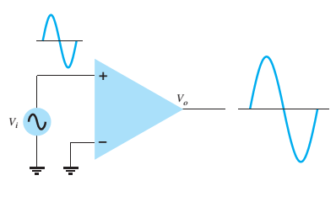
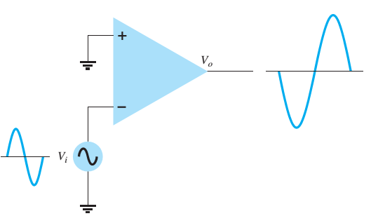
Operation of Op-Amp
The amplitude of V_{out} is higer than amplitude of V_{in}.
Same phase
Inversed phase
Notes:
The output is the amplifier of the difference between V+ and V-

Slide 7
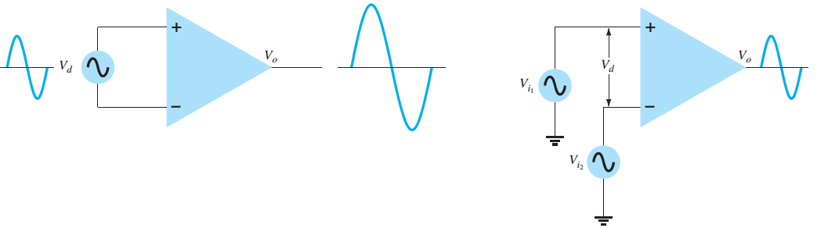
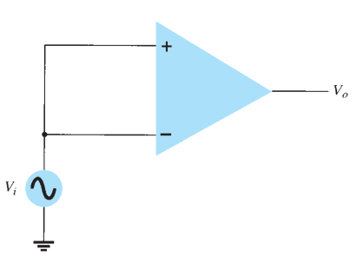
Operation of Op-Amp (cont)
The differential signal of 2 inputs is amplified.
When 2 inputs use common signal, the output is zero.

Slide 8
Real Op-Amp Models
A_{cm}: Common Amplifier

Slide 9
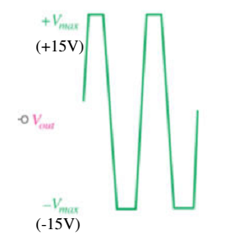
Non Feedback Circuits (Open Loop)
For the circuits without feedback (i.e. no connection between output and input), the open-loop gain is very large (>10⁵).
The output voltage will easily reach the saturation and the amplitude will be trimmed.

Slide 10
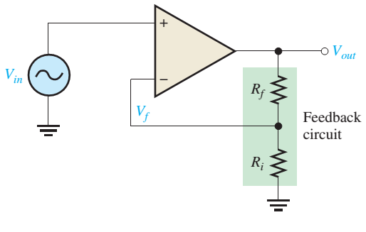
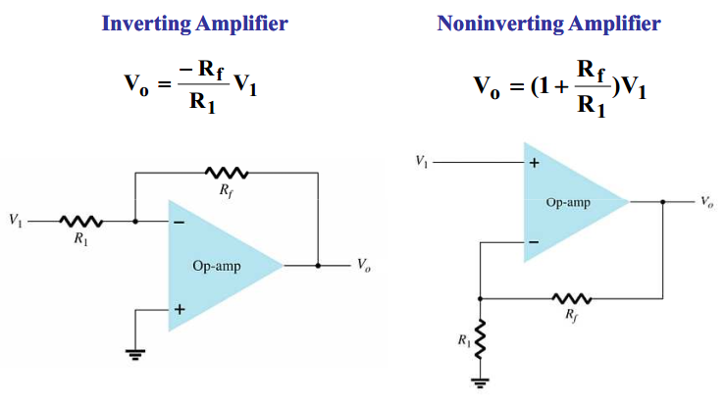
Negative Feedback Circuits (Close Loop)
In order to control the gain of an op-amp it must have feedback. This feedback is a negative feedback. A negative feedback reduces the gain and improves many characteristics of the op-amp.

Slide 11


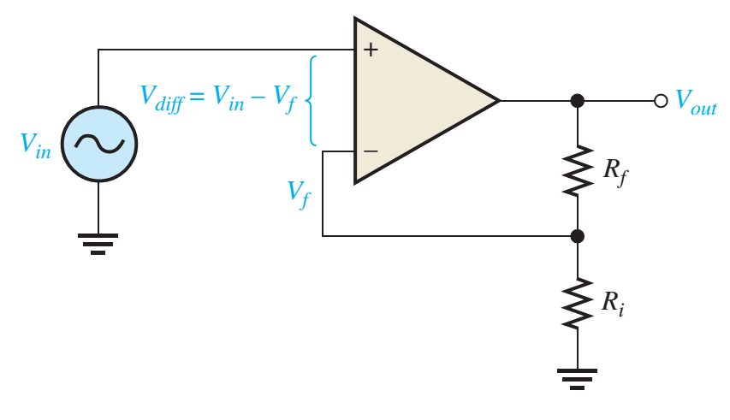



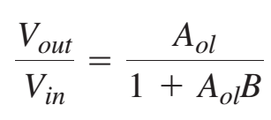
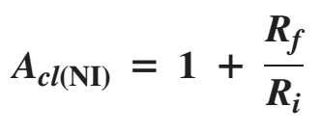
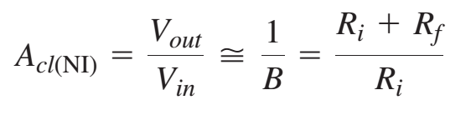
Negative Feedback

Slide 12
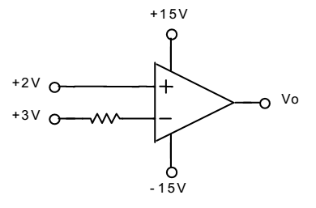
Exercise 1
Characteristics of an Op-Amp is given in the following table. The power supply is ±15V.
Determine V_{o}
Parameter | Minimum | Typical | Maximum
Output Voltage | ±12V | ±13.5V
Input Voltage | ±11V | ±12.5V
Output current of shorted-circuit | ±12mA | ±20mA

Slide 13
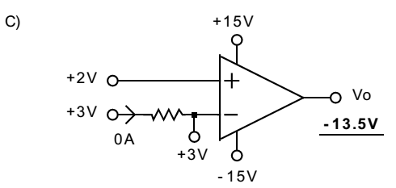
Exercise 1 - Solution

Slide 14
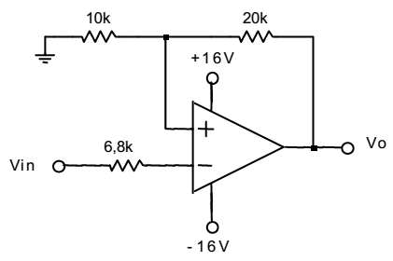
Exercise 2
Characteristics of an Op-Amp is given in the following table. The power supply is ±15V.
Determine V_{o} when V_{in}=±6V
Parameter | Minimum | Typical | Maximum
Output Voltage | ±12V | ±13.5V
Input Voltage | ±11V | ±12.5V
Output current of shorted-circuit | ±12mA | ±20mA

Slide 15
Exercise 2 - Solution

Slide 16
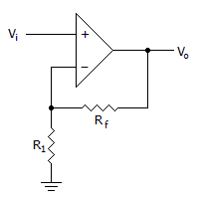
Exercise
Calculate the output gain of the circuit if R1 = 100(Ohm) and Rf = 1(KOhm)

Slide 17
Answer
11

Slide 18
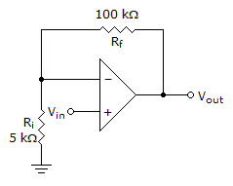
Refer to the given figure. A dc input signal of –50 mV is applied. You would measure ________ from the inverting input to ground.
50mV
1.05V
-1.05V
-50mV

Slide 19
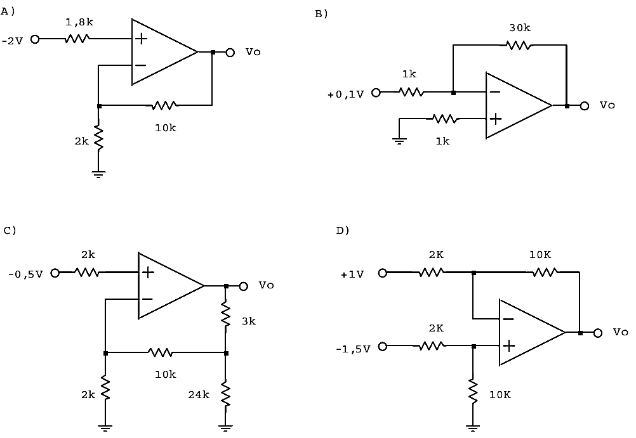
Exercise
Compute the output voltage in the following circuits using ideal op-amp

Slide 20
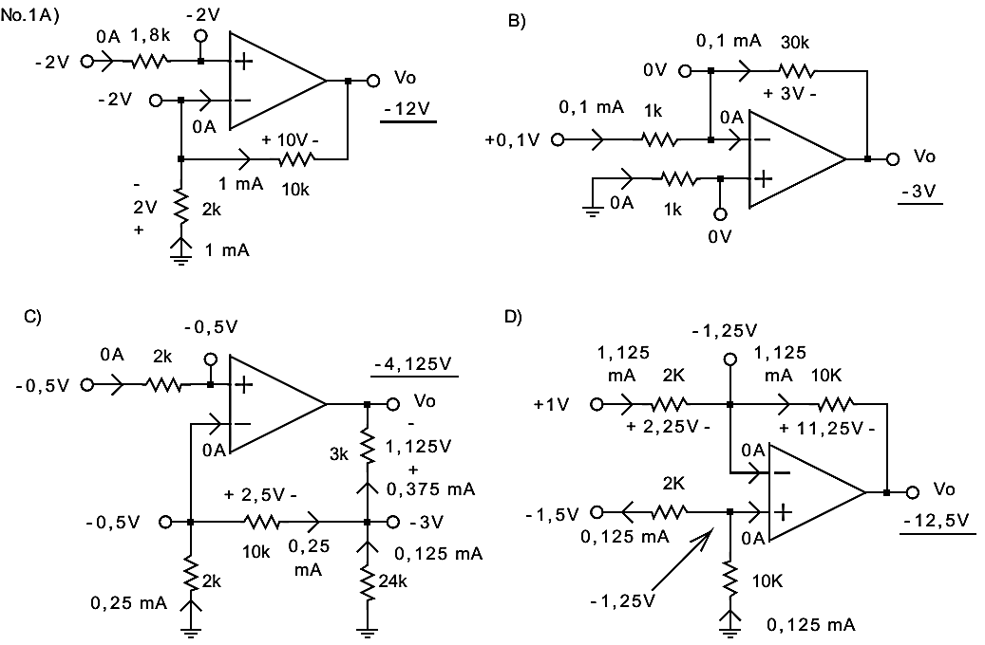
Solution

Slide 21
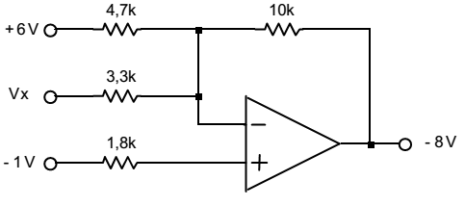
Exercise
Characteristics of an Op-Amp is given in the following table. The power supply is ±15V.
Determine V_{X}
Parameter | Minimum | Typical | Maximum
Output Voltage | ±12V | ±13.5V
Input Voltage | ±11V | ±12.5V
Output current of shorted-circuit | ±12mA | ±20mA

Slide 22
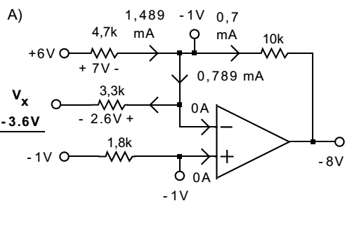
Solution

Slide 23
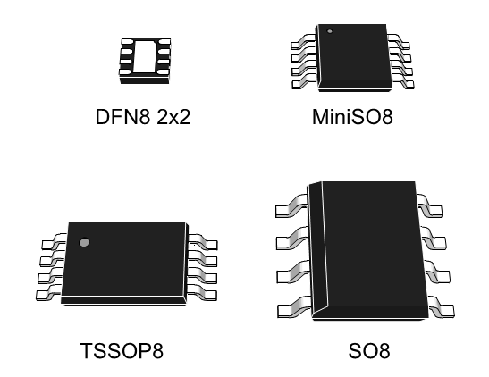
Op-Amp Datasheet
IC LM358

Slide 24
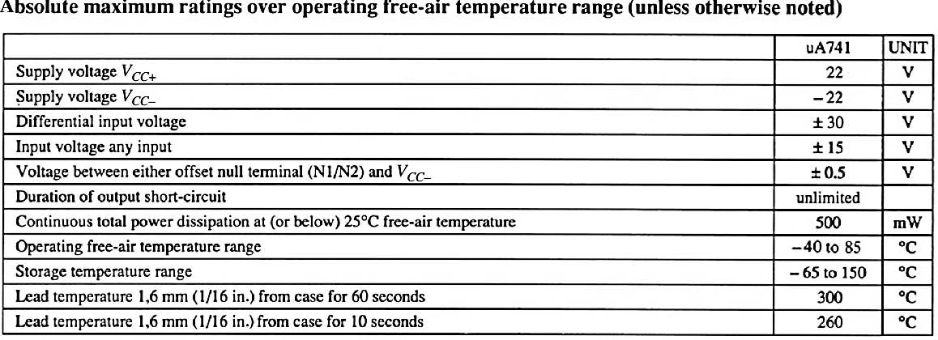
Op-Amp Datasheet (IC LM358)
Maximum power supply: ±22V
Maximum input voltage: ±15V
Maximum differential input voltage: ±30V

Slide 25
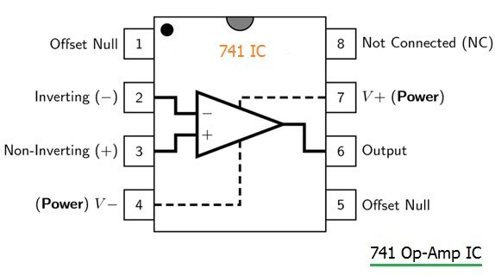
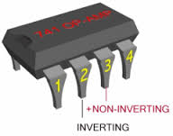
Op-Amp Datasheet
IC 741

Slide 26
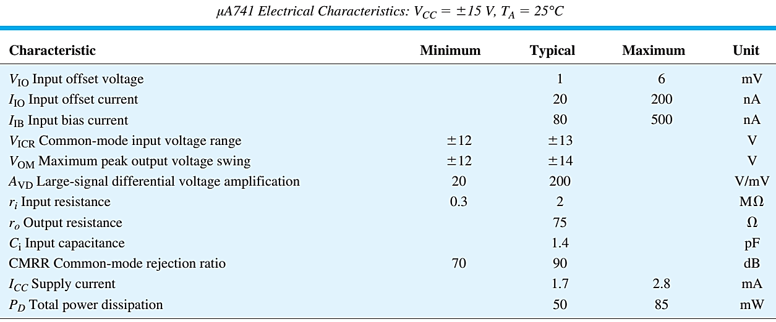
Op-Amp Datasheet (μA741)
Điện thế hoạt động 3 đến 30 → nếu nguồn đôi là ±15V
Điện thế ngõ vào từ (Vcc-) – 0.3 đến (Vcc+) – 1.5
A_{VD} – Large-signal differential voltage amplification
200V/mV = 200.000
r_{i} – input resistance: 2MΩ
r_{o} – output resistance: 75Ω

Slide 27
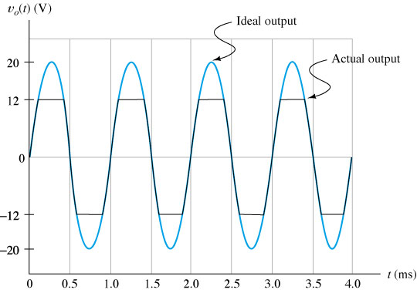
Output Voltage Threshold

Slide 28
Practical Op-Amp Circuits
Unity Follower
Summing Amplifier
Integrator
Differentiator
Comparator

Slide 29
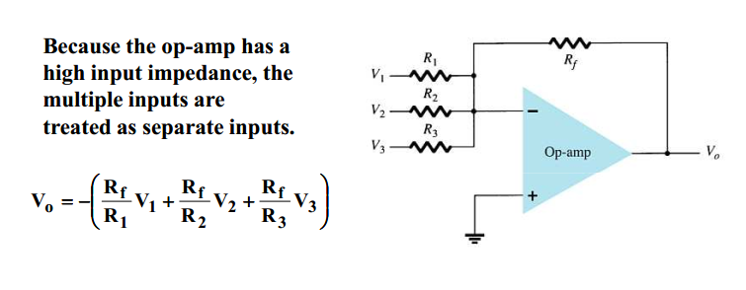
Summing Amplifier

Slide 30
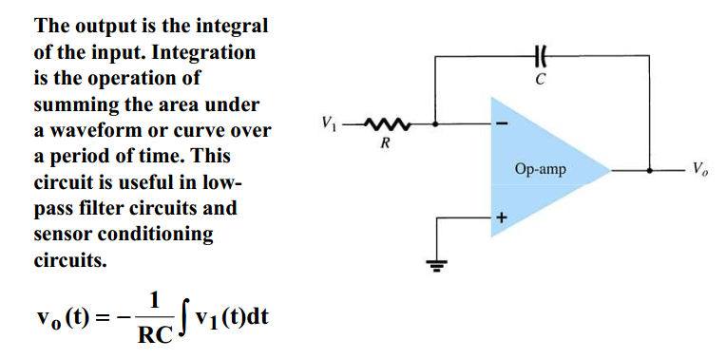
Integrator

Slide 31
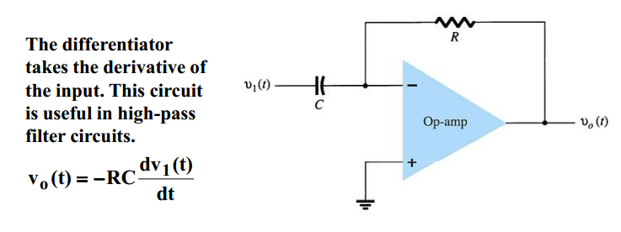
Differentiator

Slide 32
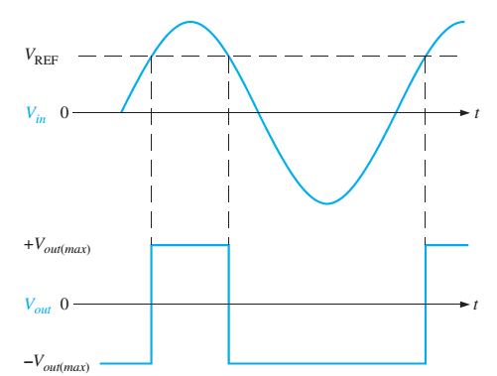
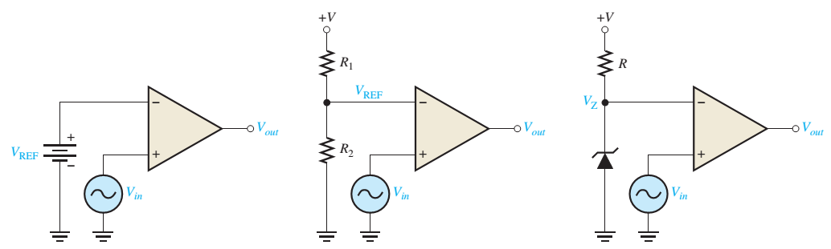
Comparator
V_{out} = +V_{out(max)} when V+ > V-
V_{in} > V_{REF}
V_{out} = -V_{out(max)} when V+ < V-
V_{in} < V_{REF}

Slide 33
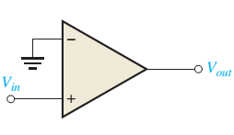
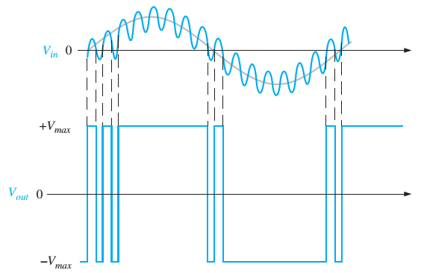
Noisy Comparator
Unexpected pulses

Slide 34
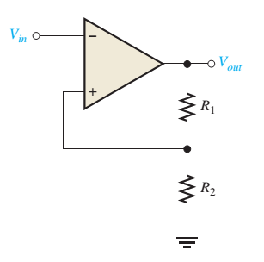


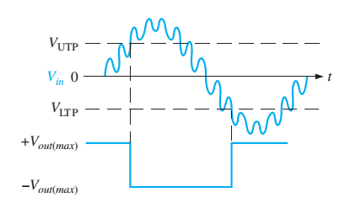

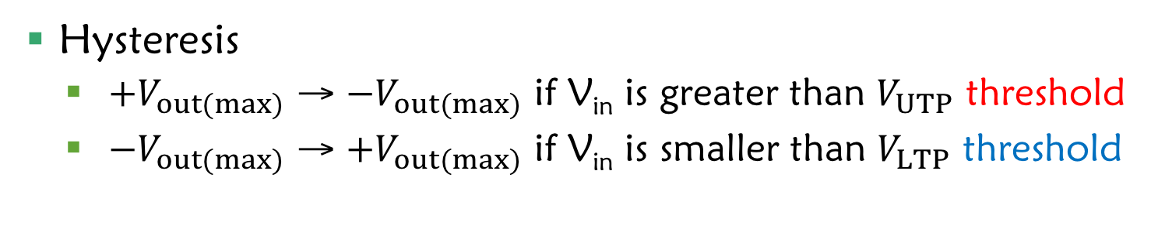
Noiseless Comparator
Hysteresis
${+V}_{out(max)}$ → ${−V}_{out(max)}$ if V_{in} is greater than $V_{UTP}$ threshold
${−V}_{out(max)}$ → ${+V}_{out(max)}$ if V_{in} is smaller than $V_{LTP}$ threshold

Slide 35
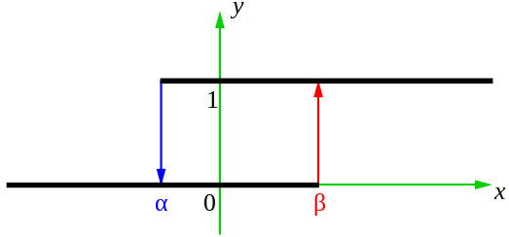
Noiseless Comparator
Hysteresis
0 →1 if V_{in} is greater than β threshold
1 → 0 if V_{in} is smaller than α threshold

Slide 36
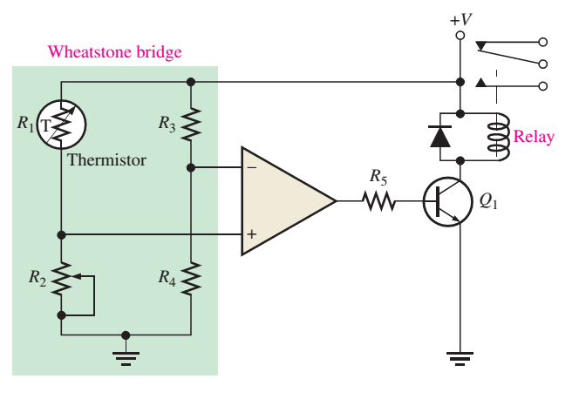
Application (1)
Protection Circuit using Op-Amp Comparator

Slide 37
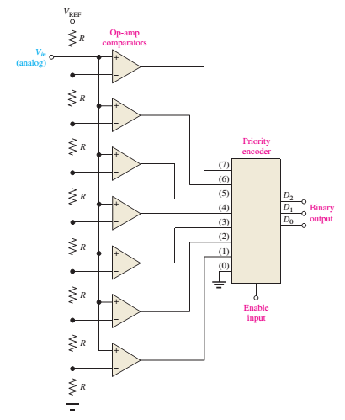
Application (2)
Analog to Digital Conversion

Slide 38
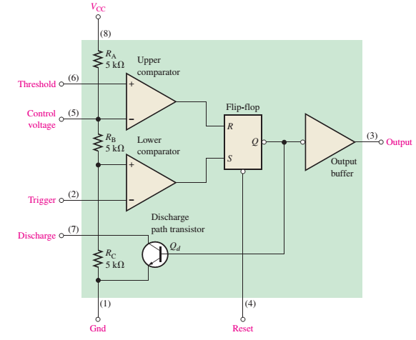
IC 555

Slide 39
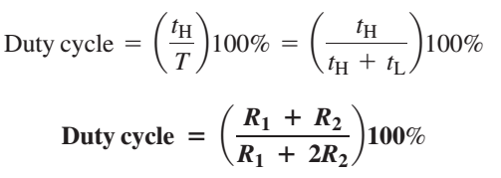
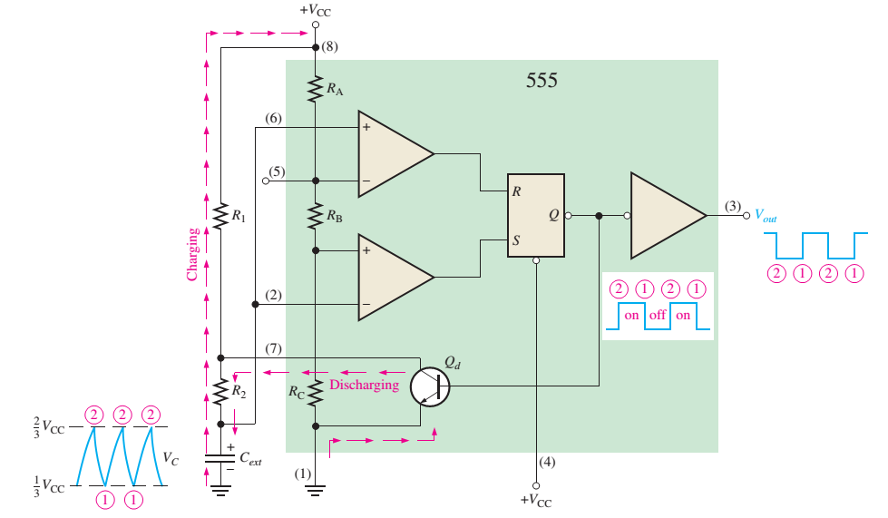


IC555 – Clock Pulse Generator

Slide 40
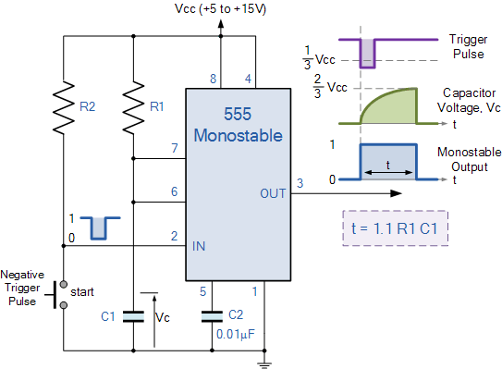
IC555 – Delay Circuit

Slide 41

Calculate the input voltage if the final output is 10.08 V
0.168V

Slide 42
Bài 3: Đáp án câu A và C
Vo = Av(2-3) = - (âm)
Av rất lớn nên Vo sẽ bị xén ở điện thế ngõ ra nhỏ nhất
Vo = V-(sat) = -13.5V

